Slide 1
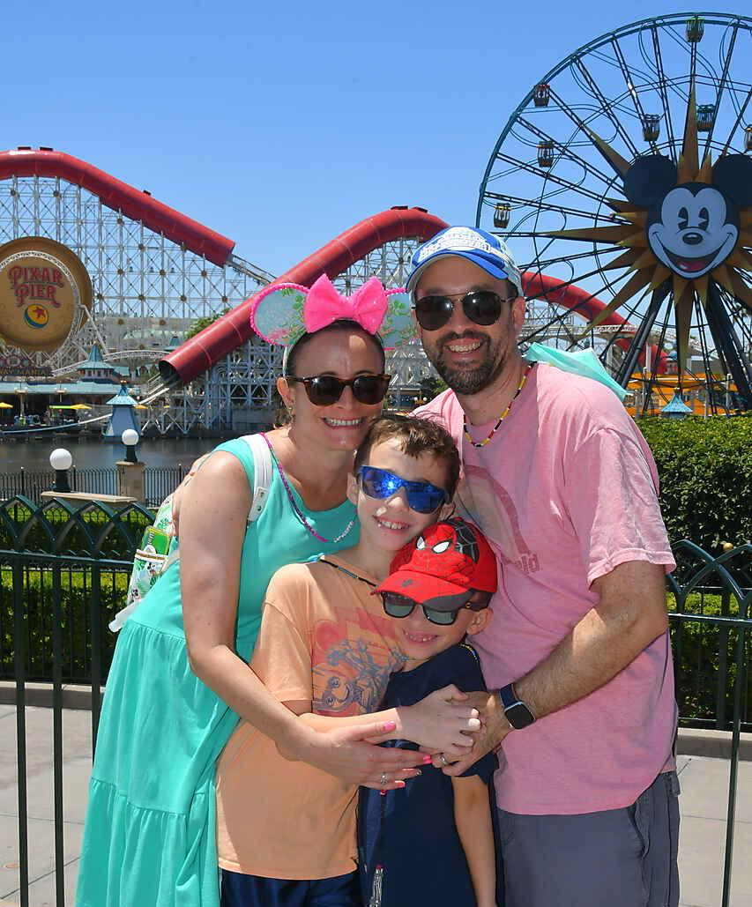
First of all, I want to say that I am so happy to be your teacher! I have been looking forward to meeting you all summer! This school year will be my 21st year teaching Pre-K 3 in Perth Amboy. I graduated with my Bachelors in Psychology from Lehigh University and my Masters in Early Childhood/Elementary Education from NYU. I grew up in Long Island. I am married to my wonderful husband, Tim for 18 years. We have 2 sons—James, who is 11 and Joey, who is 8. We are huge Disney fans! Looking forward to an AWESOME year!
MY FAVORITES
Food: Pasta
Game: Clue
Book: Oh, The Places You’ll Go
Color: Purple
Drink: Coffee
Season: Summer
Sports Team: Yankees
Fast Food: Chipotle
Animal: Cats
Hobby: Crafting

